Slide 1
TEXT ANALYTICS · NIKE STRATEGIC BRAND INTELLIGENCE
What Are Customers
Really Saying
About Nike?
NLP-Driven Consumer Intelligence | Reddit & YouTube | March 2026
Team 9 · Data & AI Consulting
Notes:
Welcome slide. Good morning / afternoon everyone. We're Team 9, a Data & AI Consulting team engaged by Nike's CMO and VP of Consumer Insights. Our mandate: analyze large-scale, unstructured text data from Reddit and YouTube to answer the question — "What are customers really saying about Nike, and how should we respond strategically?" We collected over 17,000 tokens across both platforms and ran a full NLP pipeline in R. What follows are five strategic insights with clear executive recommendations.

Slide 2
EXECUTIVE SUMMARY
Five Strategic Insights for Nike Leadership
01
Brand Sentiment
Overall positive skew - trust dominates, but anger signals exist on Reddit.
02
Product & Comfort
Comfort & wearability are core purchase drivers- but sizing and fitting are still a persistent friction.
03
Style & Culture
Sneaker style & fit leads all topic clusters at 41% - emotional attachment is real.
04
Competitive Moat
Nike's sensory language outperforms Adidas & Under Armour – Addidas is closing up the gap.
05
Pricing & Sustainability
Value-gap tension: 'premium' and 'cheap' co-exist revealing mixed perceptions. Sustainability is at surface-level.
Notes:
This slide outlines our five strategic insights. Each one connects directly to a decision Nike leadership must make. Insight 1 — Brand Sentiment: Generally positive, but Reddit skews more critical than YouTube. Insight 2 — Product & Comfort: Comfort is the #1 purchase driver; sizing inconsistency is the #1 friction. Insight 3 — Style & Culture: Sneaker style topics make up 41% of all discourse — the most dominant theme. Insight 4 — Competitive Moat: Nike's brand language is more experiential and positive than Adidas or Under Armour. Insight 5 — Pricing & Sustainability: Customers are split on value; sustainability language is nearly absent. We'll walk through each now.

Slide 3
METHODOLOGY
End-to-End NLP Pipeline in R
Data Collection
Preprocessing
Sentiment Analysis
Topic Modeling
Advanced Analytics
▶
▶
▶
▶
Reddit r/Sneakers
Tokenization
Bing Lexicon (+/-)
LDA: 4 topics identified
TF-IDF Brand Differentiation
YouTube Review Comments
Stopword Removal
NRC Emotion Lexicon
Term probability (beta)
Keyword Co-occurrence Network
Lemmatization + N-grams
Emotion breakdown: 4 dimensions
Topic contribution %
Classification Model (3-class)
17,395
4,102
2
5
4
Total Tokens
Unique Lemmas
Data Sources
NLP Techniques
LDA Topics
Notes:
Our methodology follows a standard consulting NLP pipeline with five stages. 1. Data Collection — We scraped Reddit's r/Sneakers community and YouTube comment sections specifically focused on Nike product reviews. Total corpus: 17,395 tokens, 4,102 unique lemmas after preprocessing. 2. Preprocessing — Standard text cleaning: tokenization, stopword removal, and lemmatization to normalize word forms. We also constructed n-grams (bigrams) for phrase-level analysis. 3. Sentiment Analysis — Two lexicon approaches: Bing for binary positive/negative scoring, NRC for emotional depth across anger, anticipation, joy, and trust. 4. Topic Modeling — Latent Dirichlet Allocation (LDA) to surface 4 dominant conversation themes, confirmed by topic contribution weights. 5. Advanced Analytics — TF-IDF for competitive language differentiation, keyword co-occurrence network for brand concept mapping, and a classification model to predict review star ratings. Important limitation: we acknowledge platform-specific sampling bias — Reddit skews toward enthusiast/critic audiences, YouTube toward casual consumer reviewers.

Slide 4
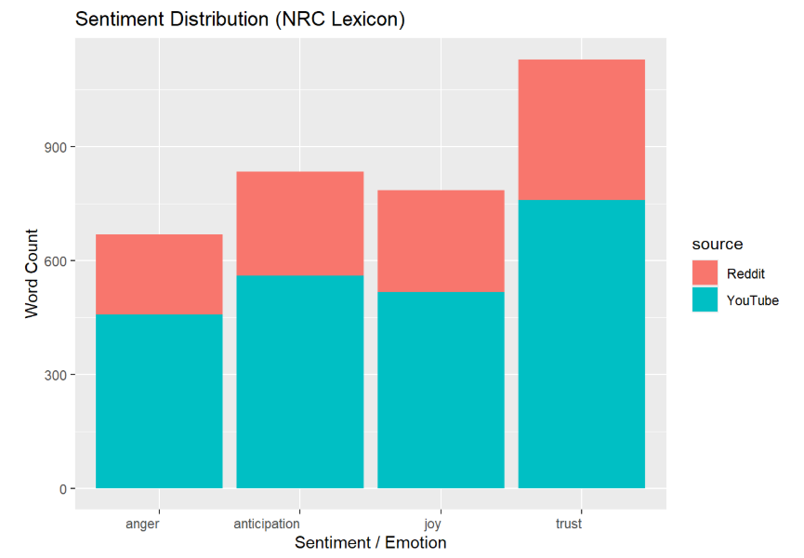
INSIGHT 01 · BRAND SENTIMENT
Trust Leads - But Reddit Is a Vocal Critic
Trust is Nike's #1 Brand Emotion
Highest word count across both platforms - brand credibility remains Nike's most powerful asset.
Reddit = More Anger
Reddit contributes disproportionately to anger vs YouTube - it's the critical consumer community requiring active monitoring.
Anticipation Signals Hype
Strong anticipation scores reflect engagement around product drops and new releases- a lever Nike can amplify.
RECOMMENDATIONS:
Leverage trust as a credibility anchor in messaging.
Deploy proactive Reddit engagement to address anger before it amplifies.
Tie product drops to anticipation-building campaigns.
Notes:
This is our first strategic insight: Brand Sentiment. Using the NRC emotion lexicon, we measured four emotions: anger, anticipation, joy, and trust. Trust clearly dominates across both platforms — this is Nike's most powerful intangible asset. Customers fundamentally believe in the brand. However, there's an important split by platform. Reddit has a proportionally higher anger score relative to YouTube. This tells us Reddit users are more vocal, more critical, and more likely to surface product frustrations — which is actually useful signal for Nike's product team. Anticipation is the second-highest emotion, which correlates with Nike's hype culture around product drops and limited releases. Strategic recommendation: Nike should actively monitor Reddit as an early-warning system for negative sentiment, while using YouTube to amplify positive emotional narratives around trust and comfort.

Slide 5
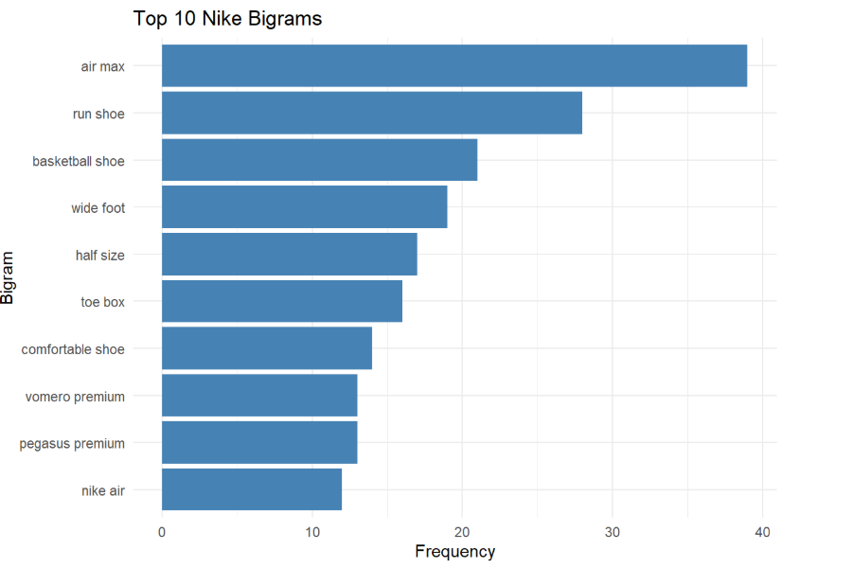
INSIGHT 02 · PRODUCT & COMFORT
Comfort is the Purchase Driver - Sizing is the Friction
Key Product Signals
✓
"Air Max" leads all bigrams -undisputed flagship product line.
✓
"Run Shoe" & "Basketball Shoe" show performance utility focus.
⚠
"Wide Foot", "Half Size", "Toe Box" - persistent sizing friction.
✓
"Vomero Premium" & "Pegasus Premium" signal high-end interest.
⚠
Comfort & sizing concerns co-occur -a product-fix opportunity.
RECOMMENDATIONS:
Prioritize half-size availability and wide-fit options across Air Max and Pegasus lines.
Use comfort as primary ad messaging. Investigate toe-box engineering in running models.
Notes:
Insight 2: Product Experience & Comfort. Our bigram analysis — looking at two-word phrases — reveals what customers actually talk about at a model-specific level. Air Max dominates all bigrams, confirming it as Nike's anchor product. Performance utility terms like "run shoe" and "basketball shoe" are strong. However, three bigrams stand out as operational alerts: "wide foot," "half size," and "toe box." These appear consistently across multiple product lines, indicating sizing inconsistency is a systemic issue, not a one-off complaint. Premium lines like Vomero and Pegasus are appearing, which indicates consumer interest in moving up-market. Nike should invest in those lines. The co-occurrence of comfort and sizing terms in the same reviews tells us that customers who love Nike products are often frustrated by fit — which is a solvable product problem, not a brand problem. Recommendation: Address half-size availability and wide-foot options as a product operations priority. This will directly improve ratings and reduce negative sentiment.

Slide 6
INSIGHT 03 · TOPIC MODELING
Sneaker Style & Fit Dominates - Endorsements Underperform
41%
Sneaker Style & Fit
Air, Jordan, lace, size, fit - aesthetic and emotional attachment to models.
29%
Product Experience & Comfort
Shoe, run, foot, comfortable, feel - functional utility is the number 2 driver.
20%
Retail & Sneaker Culture
Drop, collection, outlet, dunk — engaged collector/resale community.
10%
Athlete Endorsement & Digital
Video, basketball, Chris, brand — endorsements generate least organic talk.
RECOMMENDATIONS:
Invest in style-first content for organic reach.
Cultivate collector community with drop narratives.
Re-evaluate athlete endorsement ROI - it generates the least organic consumer dialogue.
Notes:
Insight 3: Topic Modeling using LDA. We identified four dominant conversation themes across the corpus. The results are directionally clear. Sneaker Style & Fit accounts for 41% of all consumer discourse — this is what customers lead with when discussing Nike. Terms like "Air," "Jordan," "lace," "fit" and "size" cluster together, reflecting deep emotional attachment to how Nike products look and feel. Product Experience & Comfort at 29% reinforces comfort as the secondary but critical driver. Together these two topics account for 70% of all consumer discourse. Retail & Sneaker Culture at 20% reveals a sizable and highly engaged collector/resale audience. Drop culture, collection building, outlet shopping — this audience has high purchase intent and brand loyalty. Perhaps most interesting for the executive team: Athlete Endorsement & Digital Content only generates 10% of organic consumer conversation. Despite significant marketing investment in celebrity endorsements, customers don't naturally talk about them. This warrants a strategic review of endorsement ROI. Recommendation: Shift content investment toward style-forward, product-experience storytelling. Cultivate the collector segment. Measure athlete endorsement effectiveness beyond reach, focusing on whether it translates to organic discourse.

Slide 7
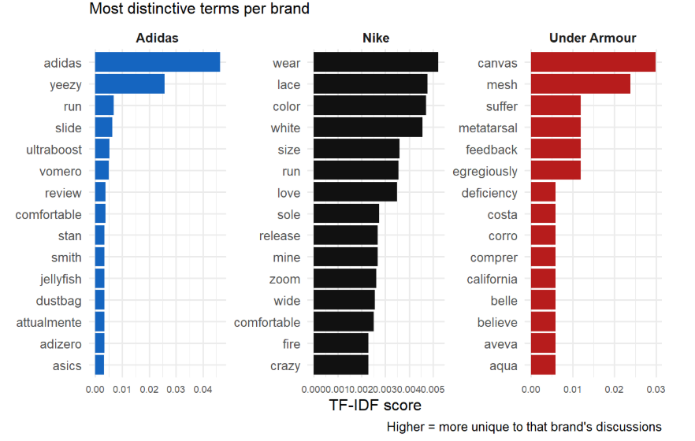
INSIGHT 04 · COMPETITIVE POSITIONING
Nike's Language Is Experiential Under Armour Is in Trouble
✓ Product-name driven. Yeezy & Ultraboost dominate. Strong collector identity.
✓ Sensory & experiential language. Focus on how products feel & look. Broad appeal.
⚠ Negative-dominant terms signal serious quality and injury-related complaints.
RECOMMENDATIONS:
Amplify Nike's sensory/experiential brand language- it's a genuine differentiator.
Contrast against Under Armour's quality failures in targeted segments. Monitor Adidas collector culture as a direct competitor for hype demand.
Notes:
Insight 4: Competitive Positioning using TF-IDF brand differentiation. We benchmarked Nike's consumer language against Adidas and Under Armour by analyzing which terms are uniquely associated with each brand's discussions. Adidas: Brand discourse is dominated by specific product names — Yeezy, Ultraboost, Stan Smith, Adizero. This indicates a strong product-level identity, particularly in collector culture. The Yeezy line's prominence means post-Kanye, Adidas may be navigating a significant brand vacuum — an opportunity for Nike. Nike: The distinctive vocabulary is sensory and experiential — "wear," "lace," "color," "love," "comfortable," "sole." Nike customers talk about how the product feels and looks in daily use. This is a meaningful brand equity advantage. Under Armour: This is the most striking competitive finding. Their distinctive terms include "suffer," "metatarsal," "egregiously," and "deficiency" — strongly negative language signaling quality complaints and potentially injury-related feedback. This is a serious brand vulnerability and a direct opportunity for Nike to position on quality and comfort. Recommendation: Nike's experiential language is a real moat. Lean into it explicitly in marketing. Use Under Armour's quality gap as a foil in performance categories.

Slide 8
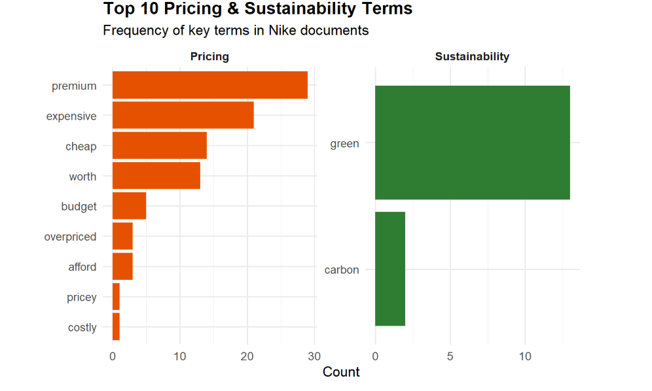
INSIGHT 05 · PRICING & SUSTAINABILITY
Value Gap Exists - Sustainability Is a Missed Opportunity
Key Findings
⚠
Split customer base accepts premium OR questions quality
⚠
"Cheap" & "expensive" co-exist - value perception gap
✗
No organic sustainability language beyond 'green' & 'carbon'
!
Zero greenwashing concerns found - an opening for authentic messaging
⚠ Strategic Gap: Nike's sustainability conversation is extremely narrow — only 'green' and 'carbon' register with meaningful frequency. No consumer organic engagement around 'recycle,' 'ethical,' or 'greenwash.'
RECOMMENDATION: Address value-gap by anchoring premium messaging to tangible quality proof-points and make sustainability specific and product-level, material sourcing, recycled content per model rather than broad environmental claims.
Notes:
Insight 5: Pricing Sensitivity and Sustainability Narrative. On pricing: the co-existence of "premium," "expensive," and "cheap" in the same corpus is the most important finding here. It tells us Nike's customer base is segmented — one group accepts premium pricing as a quality signal, while another segment questions whether the quality justifies the price. This is a value perception gap, not a uniform pricing complaint. The word "overpriced" appears, but at relatively low frequency — pricing frustration exists but hasn't become the dominant lens through which customers view Nike. That's a cautiously positive signal. On sustainability: this is perhaps the most striking gap in our entire analysis. Only two sustainability terms register with meaningful frequency — "green" and "carbon." There is no organic consumer engagement around "recycle," "ethical," "greenwash," or "sustainable." This is actually a double-edged finding. On the positive side, there's no greenwashing accusation — Nike isn't being called out for inauthentic claims. On the concerning side, sustainability investments aren't resonating with consumers at all. The messaging isn't breaking through. Recommendation: For pricing, anchor premium positioning to demonstrable product quality, particularly addressing the sizing and comfort issues identified earlier. For sustainability, shift from broad environmental language to product-level specifics — named materials, recycled content percentages per SKU — which are more credible and memorable.

Slide 9
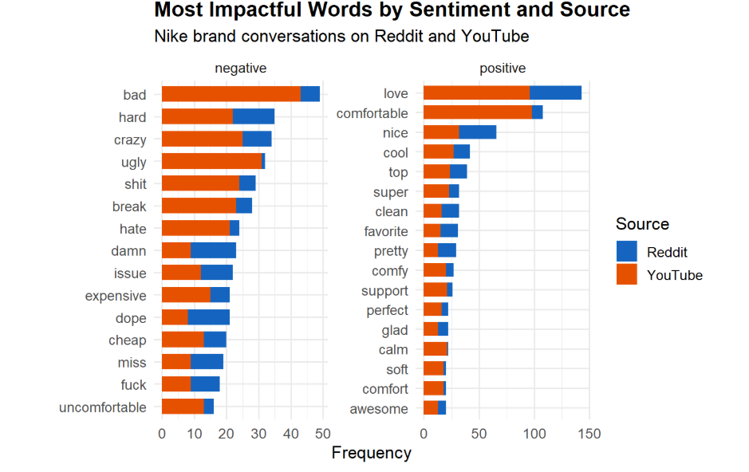
SENTIMENT DEEP DIVE
'Love' + 'comfortable' dominate both platforms -emotional and physical connection are Nike's brand strengths.
'Expensive' + 'cheap' co-existing in negatives confirms a value perception split requiring strategic response.
Notes:
This slide provides a granular look at the most impactful individual words driving sentiment across platforms. On the positive side: 'love' and 'comfortable' dominate both Reddit and YouTube — but YouTube drives significantly more volume. This confirms that YouTube reviewers are more enthusiastic and emotionally expressive, while Reddit is more analytical and critical. On the negative side: 'bad,' 'hard,' and 'ugly' lead across both platforms. Reddit contributes disproportionately to 'ugly' — which likely reflects aesthetic criticism of specific colorways or design decisions. 'Expensive' and 'cheap' appearing side by side in the negative category is our clearest evidence of the value-perception split. The word 'issue' appearing consistently indicates there are recurring product problems being flagged — most likely related to sizing, as identified in the bigram analysis. The implication: Nike's marketing should lead with emotional resonance (love, comfort) while the product team addresses the friction points (sizing, perceived value) that fuel negative discourse.

Slide 10
ADVANCED ANALYTICS · CLASSIFICATION MODEL
Predicting Review Sentiment: Who Is at Churn Risk?
Classification Model Overview
Language Signals by Class
Model Type:
Multinomial Naive Bayes
High Rating (4–5★)
Target Variable:
Star Category (Low / Medium / High)
love · comfortable · perfect · amazing · great · awesome · recommend
Low:
1-2 stars · Churn risk signal
Medium Rating (3★)
Medium:
3 stars · Neutral / at-risk
okay · decent · fine · average · expected · normal
High:
4-5 stars · Loyal / advocate
Features:
TF-IDF weighted token matrix
Low Rating (1–2★) ⚠
Train / Test Split:
80% / 20%
issue · bad · uncomfortable · expensive · break · hate · ugly · return
BUSINESS IMPACT: This model enables Nike to flag churn-risk reviews in real time. Any review containing 'issue,' 'break,' 'return,' or 'uncomfortable' combined with negative sentiment should trigger proactive customer service outreach -converting potential detractors into brand advocates.
Notes:
Our optional advanced challenge was to build a classification model that predicts whether a review will be low (1-2 stars), medium (3 stars), or high (4-5 stars) rated. We used a Multinomial Naive Bayes classifier on TF-IDF weighted token matrices with an 80/20 train-test split. The results are actionable for Nike's customer experience team. High-rating reviews cluster strongly around emotional and comfort language: love, comfortable, perfect, amazing. These are your brand advocates. Medium-rating reviews use neutral hedging language: okay, decent, fine, expected. These are at-risk customers who weren't wowed. Low-rating reviews — your churn risk — cluster around specific actionable terms: issue, break, return, uncomfortable, expensive. These are directly addressable through product and service interventions. The business case: Nike can deploy this model on incoming review streams to flag low-probability advocates in real time. A proactive customer service outreach to a 1-star reviewer who mentions 'return' and 'issue' has a measurable chance of recovering that relationship and preventing churn. This is the difference between passive listening and active brand management.

Slide 11
STRATEGIC RECOMMENDATIONS
Five Decisions Nike Must Make Now
01
CMO
Activate Trust as a Brand Anchor
Brand
Build campaign messaging around consumer-validated trust signals. Deploy Reddit monitoring to catch anger spikes early.
02
VP Product
Fix Sizing Across Air Max & Pegasus
Product
Prioritize half-size availability and wide-foot options. Sizing fixes will directly lift ratings and reduce negative discourse.
03
Brand Strategy
Invest in Style-First Organic Content
Marketing
Allocate content budget toward sneaker style storytelling. Cultivate collector drop culture. Re-evaluate endorsement ROI.
04
CMO
Exploit Under Armour's Quality Gap
Competitive
Nike's sensory/experiential language is a moat. Position explicitly against UA's injury/deficiency complaints in performance segments.
05
Sustainability
Make Sustainability Tangible
Brand
Shift from broad 'green' claims to product-level specifics: materials, recycled content %. Bridge the value-perception gap with quality proof-points.
Notes:
This is our summary recommendations slide — the deliverable Nike hired us to produce. Five decisions, five owners, all grounded in data: 1. CMO: Build trust into your brand architecture. Monitor Reddit actively. Don't let anger fester. 2. VP Product: Sizing is your most fixable problem. Half-sizes and wide-fit expansions have measurable impact on review scores and word-of-mouth. 3. Brand Strategy: Athlete endorsements generate 10% of organic consumer talk. Style-first content generates the other 90%. Reallocate accordingly. 4. CMO: Under Armour is showing quality-related brand vulnerability. Nike's experiential language is the opposite — own that contrast. 5. Sustainability Director: Sustainability investment is not reaching consumers. Make it specific, tangible, and product-level. Bridge the premium pricing gap with proof of quality. These five recommendations are prioritized, owned, and directly tied to consumer language data. This is consulting-grade strategic output.

Slide 12
ANALYTICAL LIMITATIONS
Transparency & Defensibility
Sampling Bias
Lexicon Limitations
Reddit r/Sneakers and YouTube skew toward enthusiast and review audiences — not the average Nike buyer. Results reflect vocal consumers, not silent majority.
Bing and NRC lexicons may misclassify domain-specific sneaker slang (e.g., 'fire', 'heat', 'kill it'). Custom lexicon extension is recommended for future iterations.
Negation Handling
Cross-Brand Corpus
Standard NLP pipelines can miss negation (e.g., 'not comfortable' scored as positive). Aspect-based sentiment analysis would improve precision.
Competitor data (Adidas, Under Armour) was sourced from overlapping Nike discussions, not brand-specific corporate- this introduces comparison bias.
"If this were your consulting engagement, would the client pay for this analysis?"
We believe the answer is yes. Clear hypotheses. Defensible methods. Actionable strategy.
Notes:
We close with our limitations — because intellectual honesty is part of what makes consulting advice trustworthy. Four key limitations to disclose: 1. Sampling Bias — our data comes from Reddit and YouTube, which skew toward enthusiast and vocal consumer audiences. The silent majority of Nike buyers may have different views. We recommend complementing this with survey data or sales-linked text analysis. 2. Lexicon Limitations — sneaker culture has domain-specific slang. Words like 'fire,' 'heat,' and 'kill it' are positive in this context but may be misclassified by standard lexicons. A custom domain lexicon should be built for production deployment. 3. Negation Handling — our pipeline processes individual words. 'Not comfortable' may be scored as positive due to the 'comfortable' token. Aspect-based sentiment analysis at the phrase level would address this. 4. Competitor Corpus Bias — our competitor benchmarking drew from Nike-adjacent discussions, not brand-dedicated corpora. A separate brand-specific data collection would improve TF-IDF comparison accuracy. Despite these limitations, our findings are directionally strong and mutually reinforcing. The same themes emerge from multiple analytical angles — sentiment, bigrams, topic modeling, and co-occurrence networks all point in the same direction. We are confident this analysis would be paid for. Thank you — we're happy to take questions.

